Slide 1


Challenge by Arteche

Slide 2
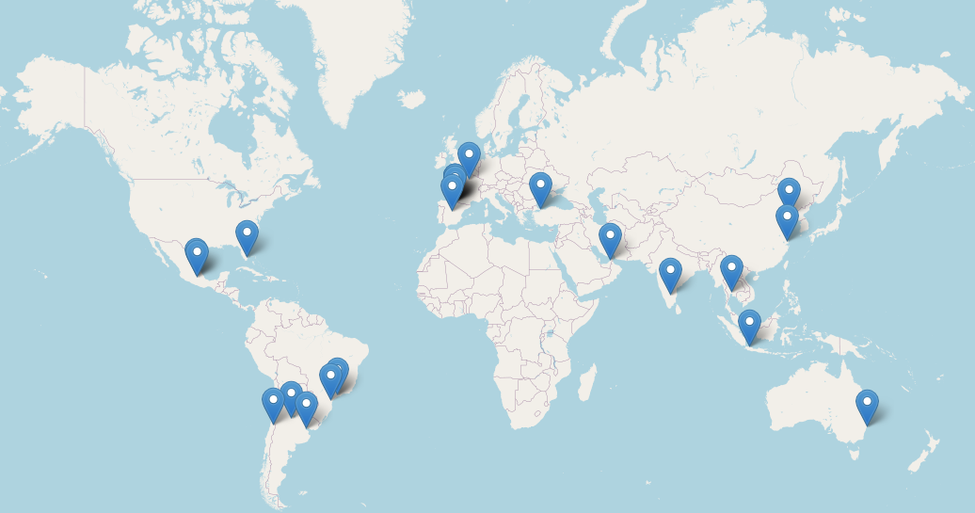
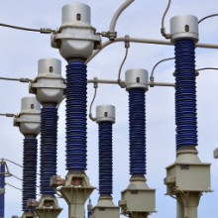
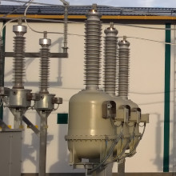
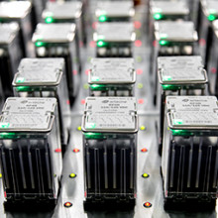
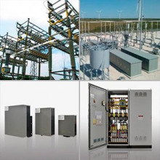
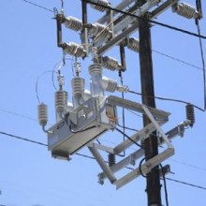

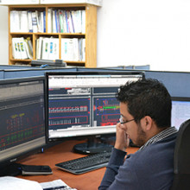
Arteche
2000 people deployed around the world within technical offices and factories
Core business: Electrical Network
Generation
Transmission
Distribution
Devices and services to deploy:
Measurement & Monitoring Systems
Transmission & Distribution Automation
Network reliability and power quality

Slide 3
Arteche Challenge
"Intelligent Energy Optimization for a Sustainable Future"

Slide 4
Challenge Context
The energy demand is constantly increasing. At the same time, there is a growing concern for sustainability and the reduction of greenhouse gas emissions.
It is essential to find innovative ways to manage the generation, transmission and distribution of electrical energy.
Big Data and Artificial Intelligence technologies can:
Provide with tools for optimizing and improving efficiency and reliability in electrical sector (Predictive maintenance, remaining useful life,…)
Promote a more sustainable and efficient approach to the generation, transmission and distribution of electrical energy.

Slide 5
Challenge Description
Desing and develop a Smart/Big Data platform → Host applications based on artificial intelligence algorithms to optimize the management of electrical energy.
Develop one application as a use case within the platform. Some of the possible applications/algorithms to develop could be:
Energy Demand Prediction: A predictive model of energy demand that uses historical data and relevant variables (such as weather and economic data) to predict future energy demand with high precision. This will help electric companies better manage energy generation and distribution.
Energy Generation Management: Design an energy generation management system that uses real-time data and AI models to optimize energy production from renewable sources such as solar and wind, minimizing resource waste.
Any other algorithm proposed by the team.

Slide 6
Challenge Requirements
The designed platform should cover at least the next submodules:
Ingestion module
Data storage module (datalake)
Data processing module
Artificial intelligent module
Graphical user interface
Teams must use real data from the electrical sector in their solution. To do this, they will make use of public sources such as (https://catalog.data.gov). An example would be the "Residential Energy Consumption Survey (RECS) Files."
Teams must provide evidence that their solution is scalable and practical for real-world implementation.
The final presentation should include a technical report and a live demonstration of their solution.

Slide 7
Challenge Evaluation
Projects will be evaluated based on:
Innovation
Performance, scalability, reliability,... of the designed platform
Real-world applicability
UX of the platform GUI
Quality of the presentation.
AI model accuracy will also be considered, but it will not carry as much weight as the previous criteria.

Slide 8


